Slide 1
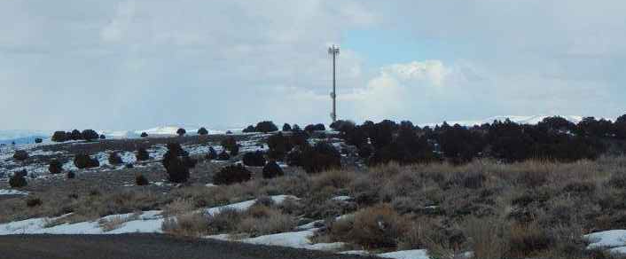
WSUP19-0003 Vya Monopole
View: East
Washoe County Board of Adjustment
June 6, 2019

Slide 2
Overview
General Rural– Cell Tower permitted by SUP
Fill a gap in coverage in northern Washoe County
Unmanned facility located in rural area
Will be visible from road
No other towers in the area
Built with the ability to collocate future projects
Improved coverage for First Net emergency responders as well as wireless coverage

Slide 3
Request
Construct and operate 150’ tall monopole with supporting equipment
Vary Landscaping requirements

Slide 4
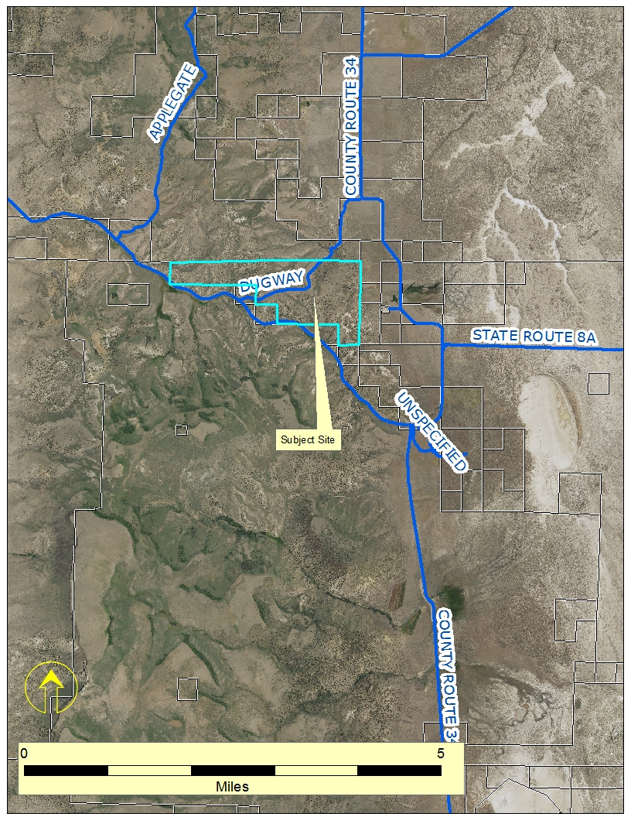
Vicinity Map

Slide 5
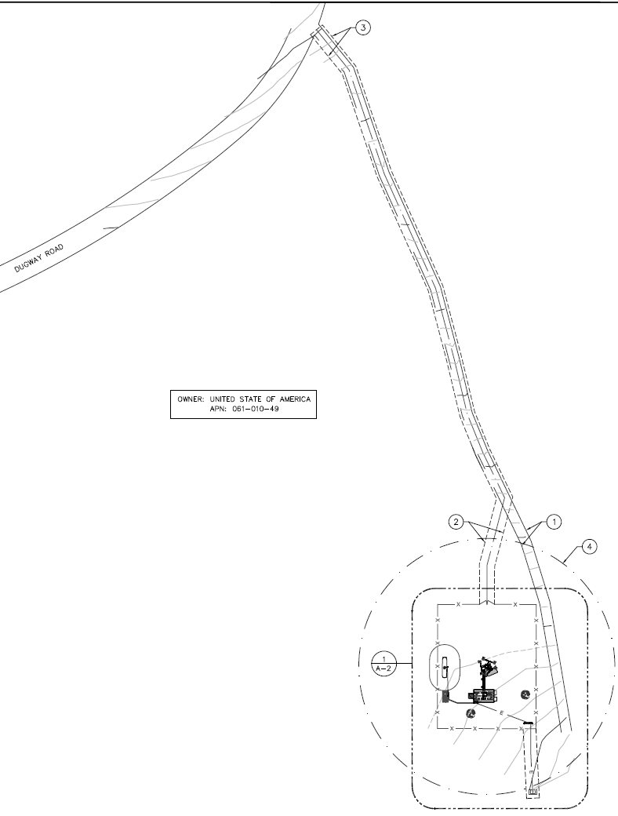
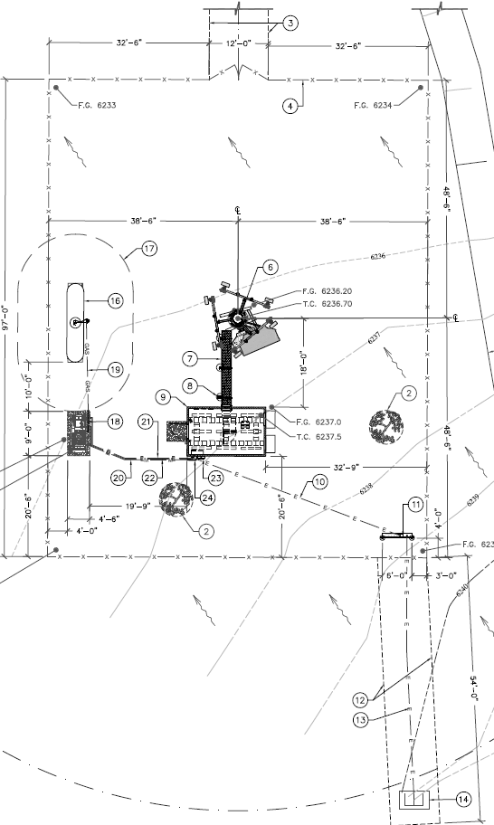
Site Plan

Slide 6
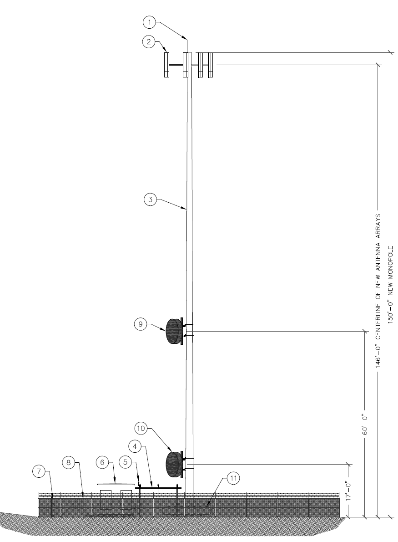
Elevations

Slide 7
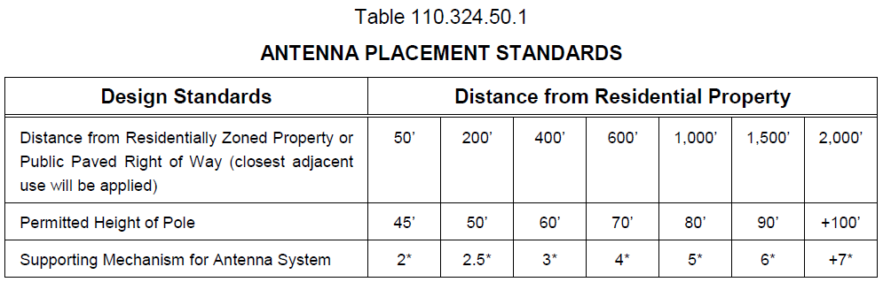
Analysis – Height and Visual Impact
Proposed tower height of 150 feet meets code
The allowed height (in GR) is governed by the placement standards of WCC Table 110.324.50.1
The tower is >2000 feet from nearest paved right of way

Slide 8
Alternative Site Analysis
Alternative sites were considered in cooperation with the BLM. This site was chosen for the level of impact to wildlife, landscape and access

Slide 9
Citizen Advisory Board/Public Comment
The Gerlach/Empire Citizen Advisory Board reviewed the application on May 9, 2019
The CAB requested more projects of this type and unanimously recommended approval
Staff received several e-mailed responses from the public expressing approval for the project

Slide 10
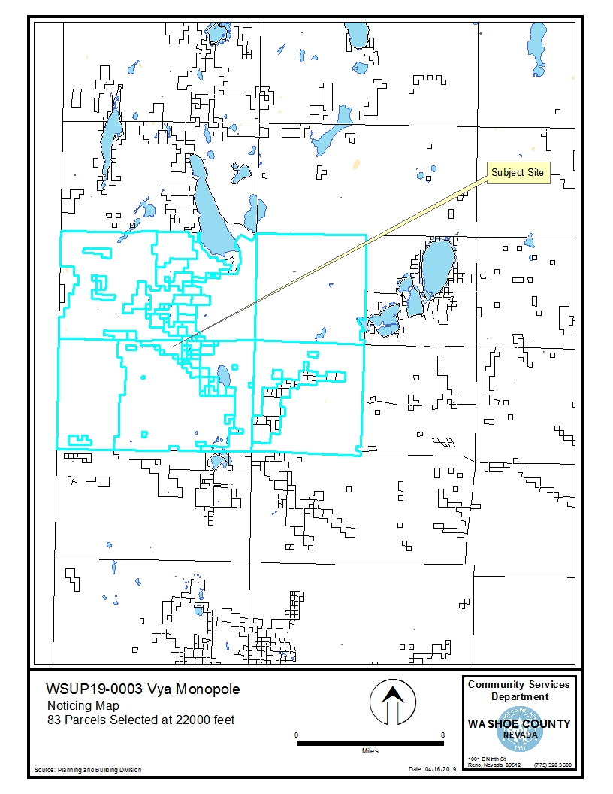
Mailing Notice Map

Slide 11
Reviewing Agencies
Washoe County Community Service
  Planning and Building Division
  Engineering and Capital Projects
  Operations
Washoe County Health District
  Air Quality Management Division
  Environmental Health Services Division
  Emergency Medical Services
Washoe County Animal Services
Regional Transportation Commission
Nevada Historic Preservation
Washoe-Story Conservation District
Nevada Department of Wildlife
Nevada Department of Environmental Protection
Bureau of Land Management
U.S. Fish and Wildlife

Slide 12
Special Use Permit Findings
1. Consistency
2. Improvements
3. Site Suitability
4. Issuance Not Detrimental
5. Effect on a Military Installation
After a thorough analysis and review, Special Use Permit Case Number WSUP19-0003 (Vya monopole) for Commnet of Nevada LLC is being recommended for approval with conditions.

Slide 13
Possible Motion
I move that, after considering the information contained within the staff report and the information received during the public hearing, the Washoe County Board of Adjustment approve, with the conditions included at Exhibit A to the staff report for this item, Special Use Permit Case Number WSUP19-0003 (Vya monopole) for Commnet of Nevada LLC being able to make the findings required by Washoe County Code Section 110.810.30, Section 110.324.75, and consistency with the High Desert Area Plan.

